Slide 1
TSA KN March 2021 Knowing Your Energy Usage
Energy Audits and Funding Opportunities!!

Slide 2
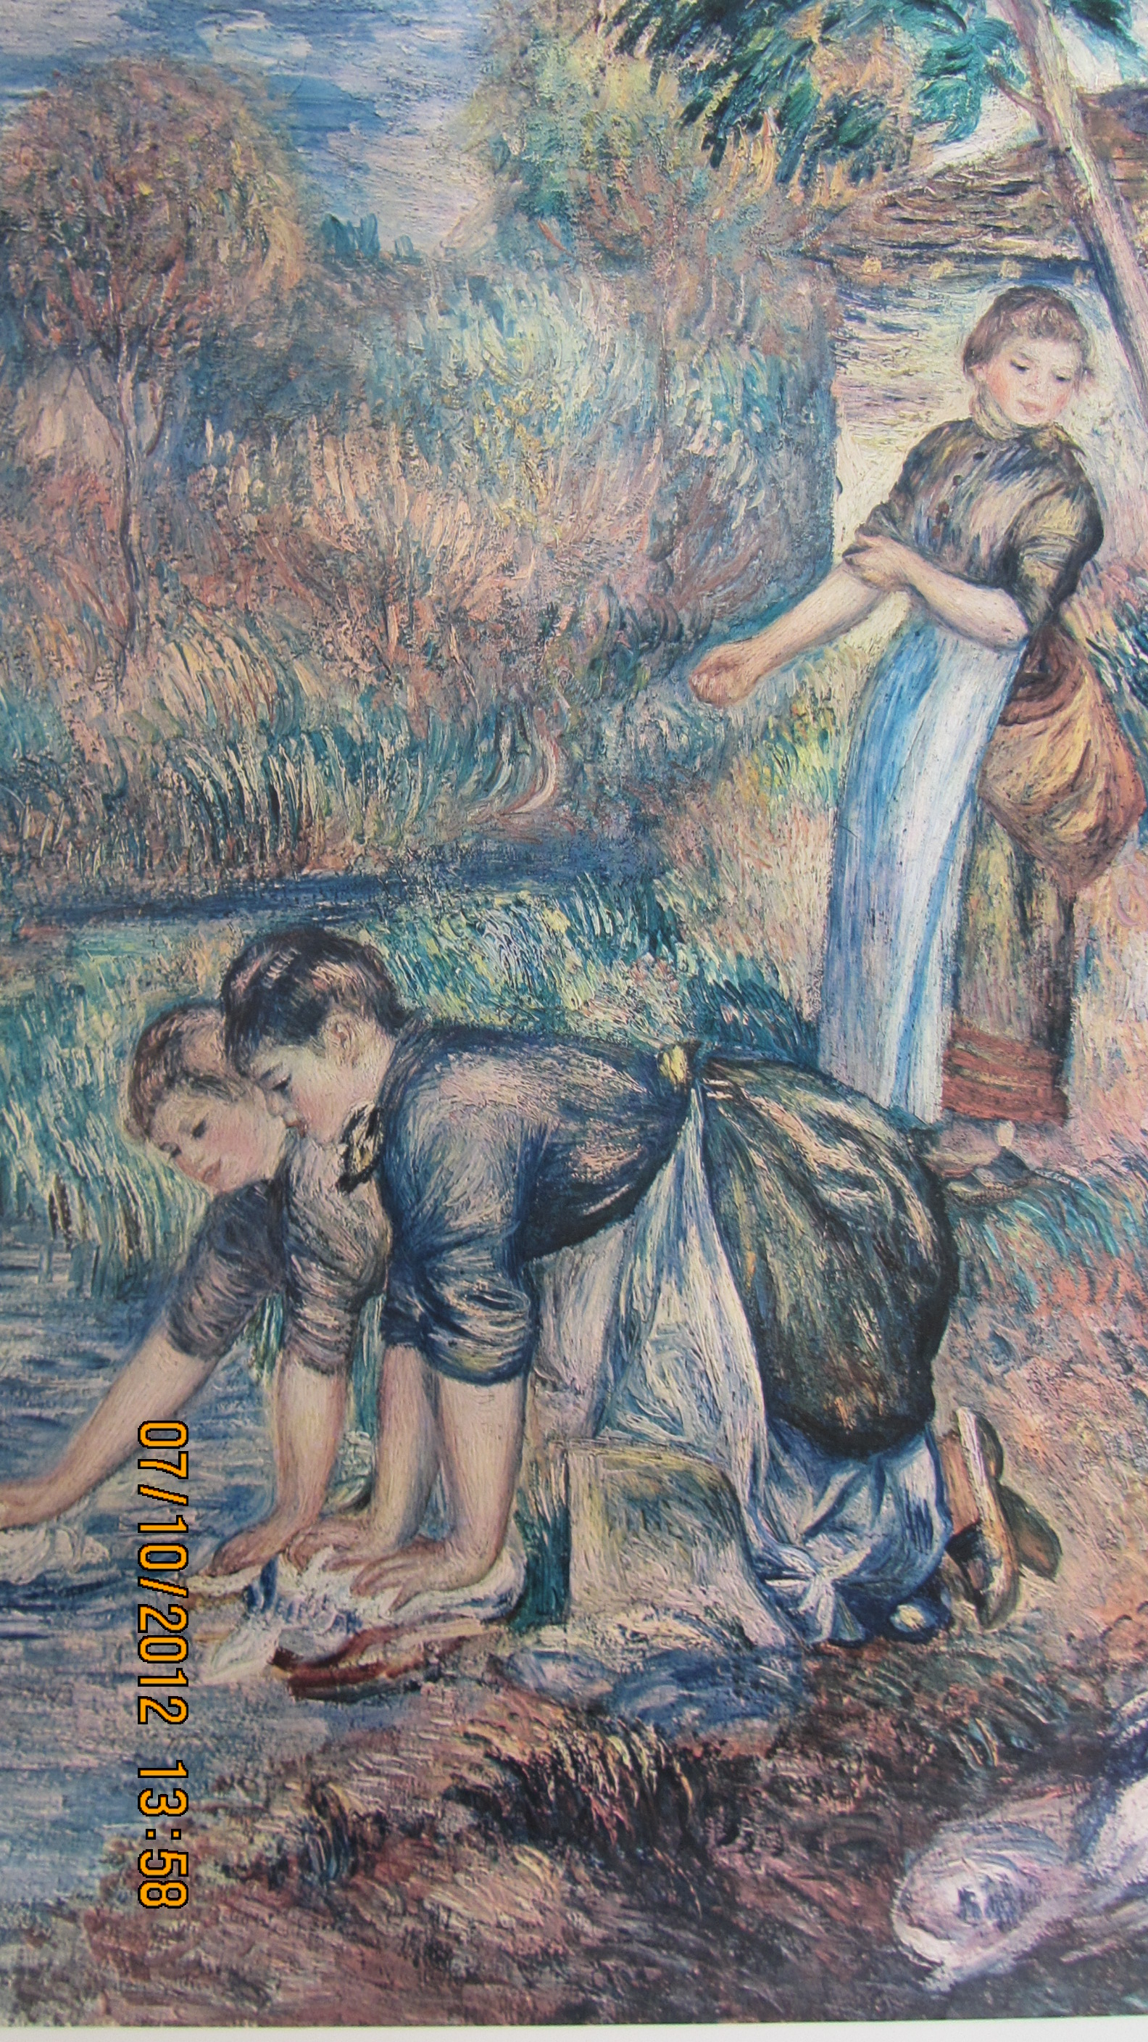

Slide 3
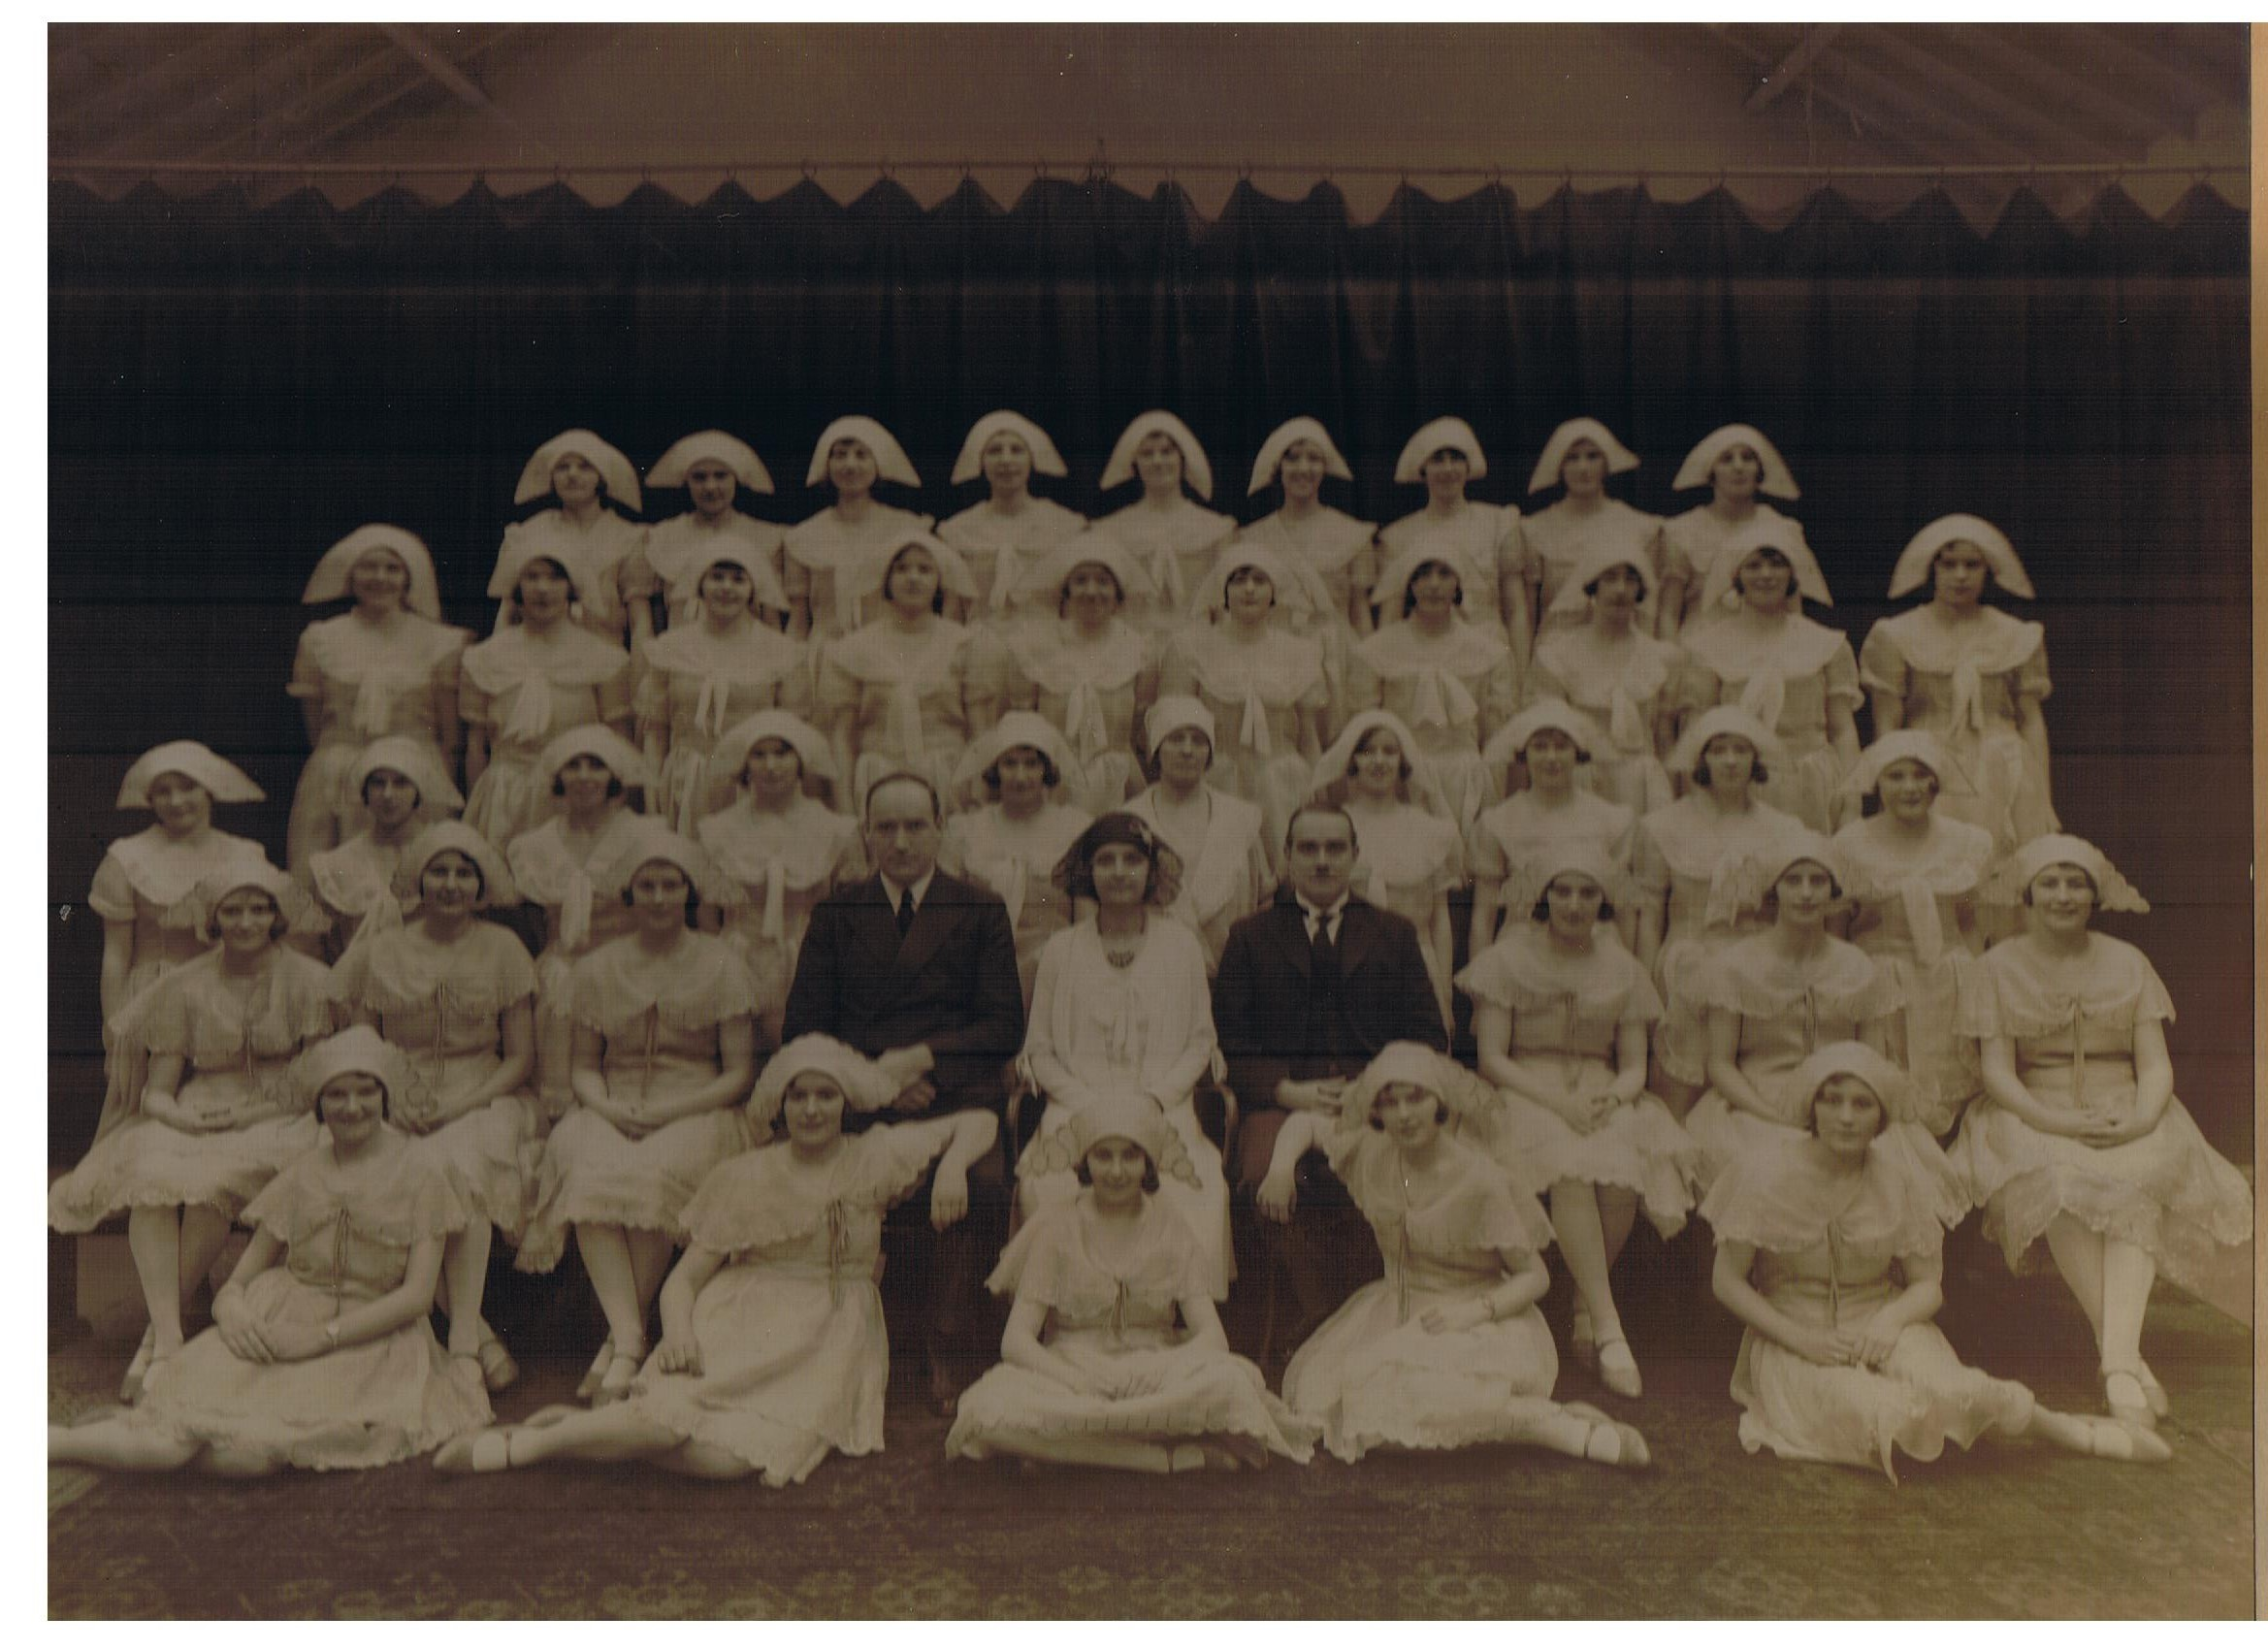

Slide 4
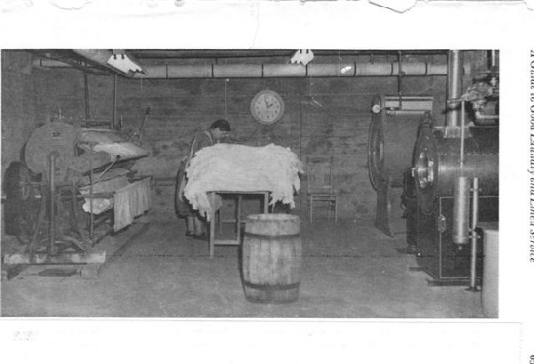

Slide 5
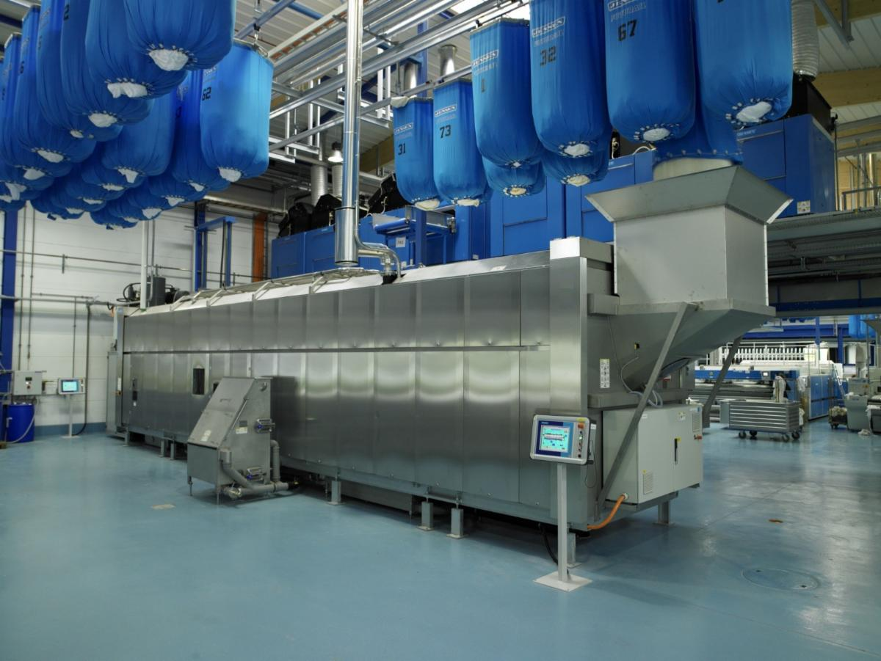

Slide 6
INDUSTRY COST CAKE
Labour 40%
Textiles/stock 15%
Chemicals 10%
Depreciation 10%
Transport 12%
Energy 6%
Maintenance 3%
Water/effluent 2%
Admin 2%

Slide 7
Buzz Phrases over the Years
Save It
Switch it off
Energy Conversation!?
Resource Efficiency
Circular Economy
Sustainability
Life Cycle Analysis
Climate Change Agreement
Heat Recovery and Recycling
Best Demonstrated Practice
Benchmarking
Global Warming
Climate Change
Green Deal
Zero Carbon Emissions by 2050
Enhanced Capital Allowance
Industrial Energy Efficiency Accelerator Programme
Industrial Heat Recovery Scheme
Industrial Energy Transformation Funds
Industrial Decarbonisation Strategy

Slide 8
Here to Help since 2008? The Carbon Trust!!
Opportunities Site Surveys by a CT consultant – Free of charge
SME Loan Scheme
Carbon Reduction Commitment Energy Efficiency Scheme
Laundry Industry Guide
Carbon Footprinting
Water Footprinting
Industrial Energy Efficiency Accelerator 2010
Industrial Energy Efficiency Accelerator 2017
BEIS IEEA 2019
BEIS Industrial Heat Recovery Support 2019
Industrial Energy Transformation Funds

Slide 11
Carbon Trust IEEA ‘Innovative Projects’
Development of industry process model (benchmarking and analytics tool): to identify the variances and impact of one part of the process on another, e.g. moisture retention, residual temperature, air flow the effect on drying and finishing.
Move towards polyester based towels which will weigh 30% less with an expected reduction in energy.
Develop a method to update low-grade heat into a more usable format and the use of heat pump technology (Mechanical Vapour Recompression).
Retro-fit humidity and temperature sensing/control on tumble dryers.
Dust mat design and construction to optimise water and soil release in processing and alternative drying method.
Develop the use of modular steam, hot water and compressed air generation for designated integral application; alternative to main plant and distribution system.

Slide 12
Opportunities? But now Threats
Project Funding
Climate Change Levy Exemption through Climate Change Agreement
ESOS Phase 2 (Large companies only)
ISO50001 is an alternative
Medium Combustion Plant Directive
BSEN 17116; Industrial Laundry Machines Capacity and Consumption (Energy Performance and Eco-Labelling!!)

Slide 13
WHAT CAN WE DO NEXT?
Site Energy Audit
Review Low Hanging Fruit
Review Best Demonstrated Practices
Review Industry Bench Marking KPIs
Monitor , Target and Manage Your Site
Keep it Simple
Assess the Basics
Reference Industry Knowledge and Expertise; Past and Present

Slide 14
SIMPLES
Switch off’ – lights, office equipment, air con, all local electrical heating, equipment over lunch-time (sensibly).
Delay start-up time for all services generating equipment by 1/2h
Interlock high demand equipment (wash/exts) to reduce peak demand
Install power factor reduction systems to achieve unity power factor
Install soft start/inverter control to all motor drives on wash/exts, ironers, etc
Implement tariff analysis and lowest cost purchase (these studies essentially cost based, but identify savings).
Lighting surveys often have high capex, but massive consumption savings.
Compressor leakage survey
Boiler operation and modulation control survey
Condensate return heat recovery direct to boiler feed inlet
Water ring main pumping systems - convert to inverter drive
Air handling systems – convert to inverter drive

Slide 15
BASICS
Recycling of process effluent to reduce water consumption by up to 75%
Effluent heat recovery to be used to pre-heat process water at various key stages, both in washer/extractors and continuous tunnel washers
Exact sorting and segregation of work into the correct load sizes to ensure optimum processing using the minimum utilities, time and chemicals to achieve the correct quality with zero rewash.
The complete and prompt utilisation of finishing equipment (ironers, presses and tumble dryers) to utilise the residual heat in washed loads.
Tumble dryers should ideally be direct gas heated with exhaust heat recovery/recirculation and temperature and humidity control to ensure optimum drying
Eliminate waiting time and lunch breaks, maintaining continuous processing with equipment always fully utilised and never idling.
Remove all redundant pipe-work and ensure all steam distribution lines are correctly drained and insulated. Maintain steam traps as a priority.
Daily meter reading, trend analysis and periodic auditing
Maintain work throughput production and productivity records, hourly
Seek expert guidance to ensure all opportunities are appraised for energy saving through investment in alternative technologies.

Slide 16
TSA – Technical Support
Expertise
Experience
Reference Data and Contacts
Industry Guidelines
Best Demonstrated Practices
Share Knowledge through Network Groups

Slide 17
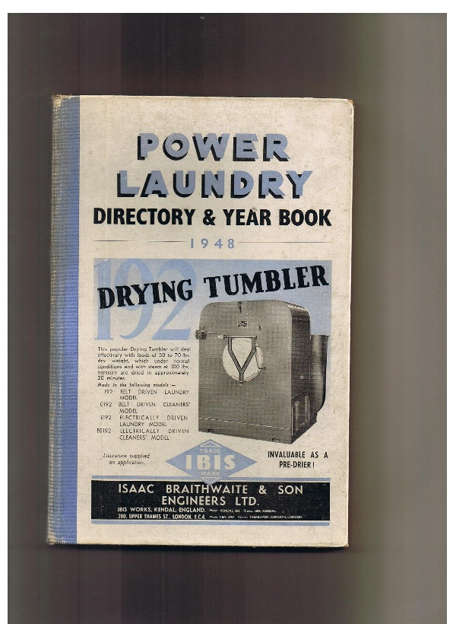
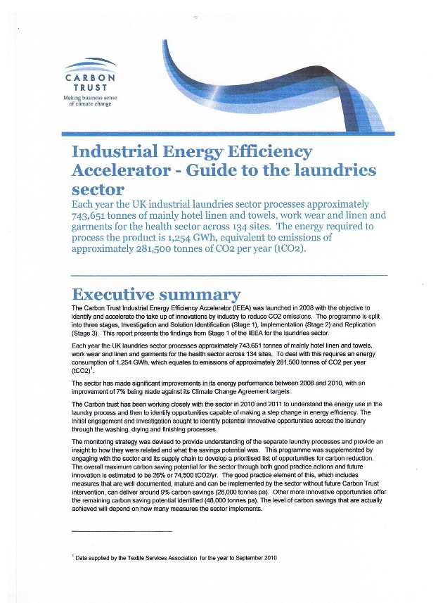
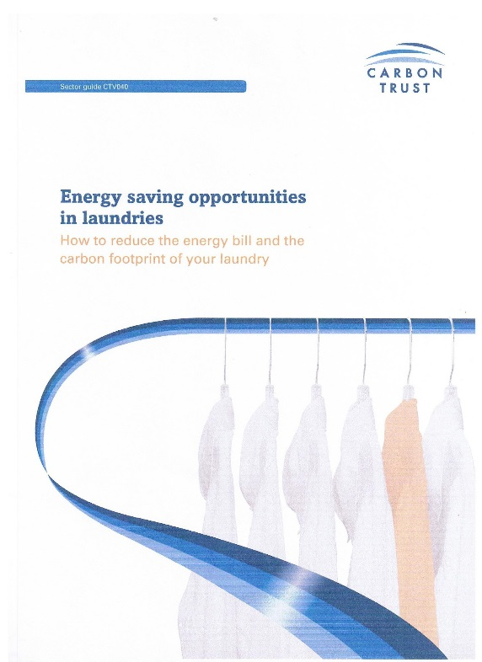
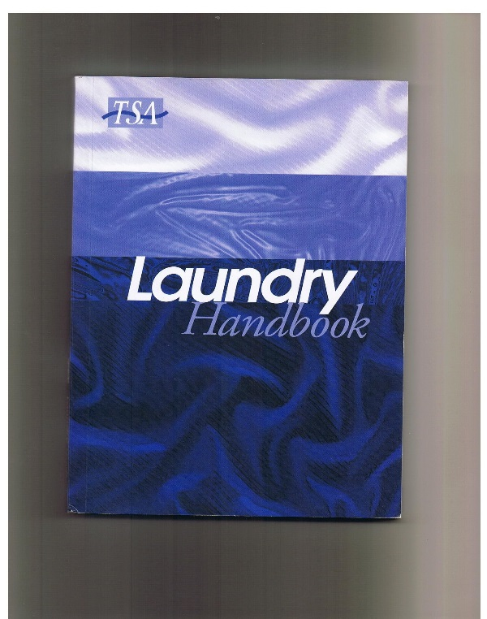
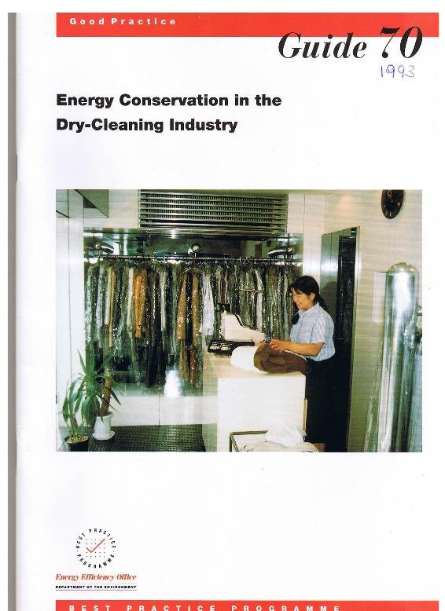
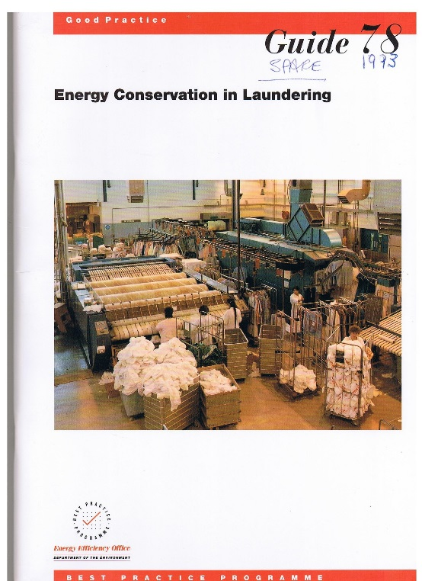

Slide 18
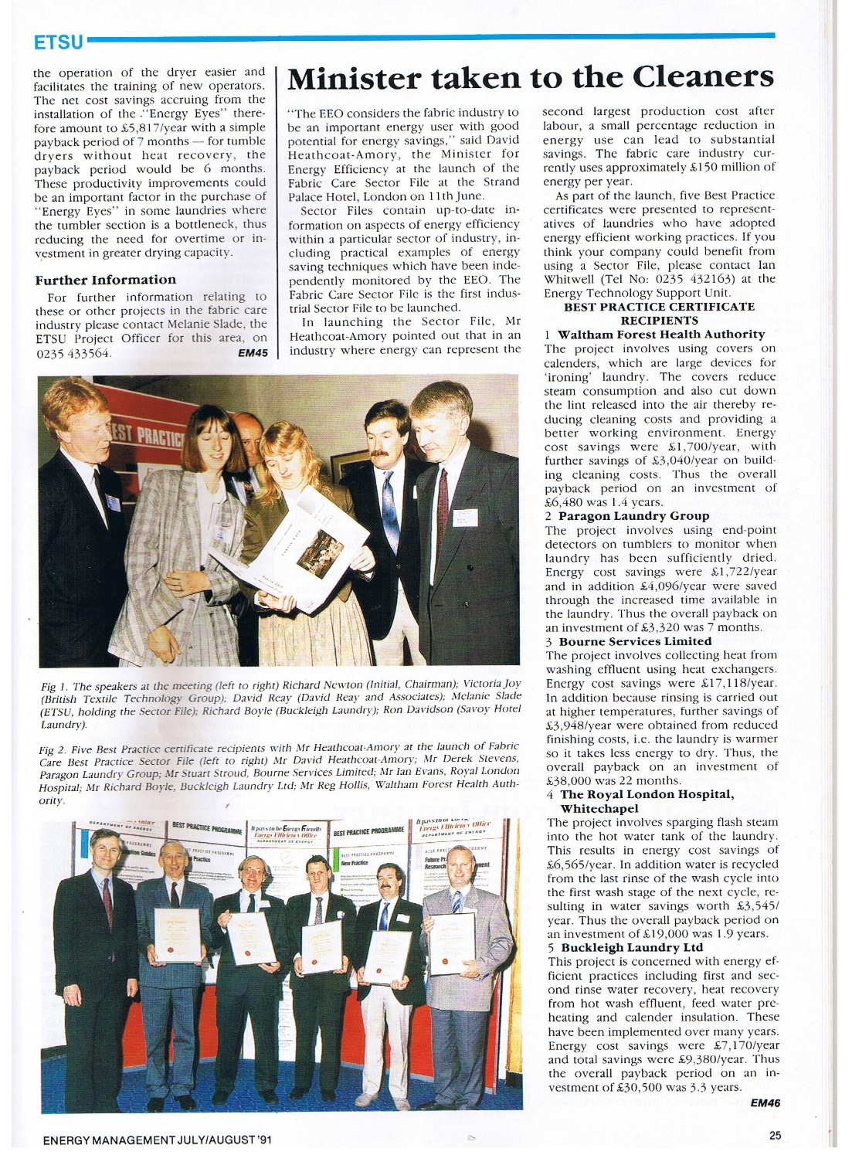
And We’ve Done it! Albeit a few years ago!!

Slide 19
TSA Energy Seminars; a Summary
2016 – Achieving the next 5%
2018 – Monitoring, Targeting, Best Practices and Opportunities
2019 - Jacobs reviewed our position
- Jensen presented the latest technology; the closed loop process
- Lilliput described in detail how they had achieved target
- TSA are here to help
2021-TODAY

Slide 20
BUT THERE MAY JUST BE SOME NEW FUNDING OPPORTUNITIES??
New Fan and Motor Technology from ebm-papst; (retro-fit and new equipment - discussions on-going)
Voltage Optimisation; Powerstar - discussions ongoing
Industrial Heat Recovery Support; BEIS/ICF - discussions ongoing to identity projects for funding
Remote Monitoring and Controlling of Laundry Equipment; Optimised Processing and Fault Correction

Slide 21
THE NEXT STEPS
ENERGY AUDITS !!
INNOVATIVE PROJECT FUNDING??
IMPLEMENT PROVEN TECHNOLOGY – FUNDING OPPORTUNITY??
ACHIEVE CCA TARGET OVER THE NEXT 2 YEARS!!
NET ZERO 2050!!

Slide 22
TSA ENERGY AUDIT
Based upon the original Carbon Trust and ESOS format
See sample

Slide 23
Priority (in respect of operational timing) | Recommendations |  |  |  |  |  | Timescale for implementation and by whom | May be eligible for ECA* | May be eligible for loan*
 |  | Estimated annual savings |  |  | Estimated cost (£) | Payback period (years)
 |  | (£) | CO₂ (tonnes) | (kWh)
1 | Bld1 Space heating laundry | 3,000 | 17.3 | 91,000 | 5,000 | 1.67 | 6 - 12 Months | Y | Y
2 | Bld 1Space heating 2- level offices/storage/work area | 4,500 | 26.2 | 138,000 | 7,000 | 1.56 | 6 - 12 Months | Y | Y
3 | Bld 1Space heating warehouse | 6,000 | 34.6 | 182,000 | 10,000 | 1.67 | 6 - 12 Months | Y | Y
4 | Bld1 Steam distribution pipe work must be lagged to recognised standards to reduce heat loss and comply with H&S. | 2,750 | 15.2 | 80,000 | 5,250 | 1.91 | 3 - 6 Months | Y | Y
5 | Bld1 The laundry operation was evaluated and key recommendations have been implemented. To balance the wash and finish capacity in order to reduce operating hours through enhanced productivity, investment is required in 2 no. new washer extractors which will also be current specification efficiency rating | 3,600 | 9.4 | 49,500 | 25,000 | 6.94 | N/A | Yes (from water technology list) | Y
6 | Bld1 The lighting system is ancient and inefficient. An entire new system should be installed to provide the correct lighting in the required areas which can be controlled by time and occupancy requirement. | 1,800 | 6.45 | 15,000 | 6,500 | 3.61 | 0 - 3 Months | Y | Y
7 | Bld1 The electricity demand is of low power factor due primarily to the space heating system fan and pump motors, but also the washer/extractor drive motors. Powerperfector have been contracted to evaluate the current situation and define an improvement plan. | 2,500 | 10.7 | 24,960 | 7,000 | 2.80 | 3 - 6 Months | Y | Y
TOTAL |  | 24,150 | 102.7 | 580460 | 65,750

Slide 24
Carbon Footprint Quantified Emissions Breakdown
Emissions Type | Emissions Source | Emissions | Purchased Energy |  | Cost
 |  | tCO₂e | kWh/yr | % |  | £/yr | %
Direct Emissions | Gas | 331 | 1,739,710 | 89 |  | 57,270 | 69
 | Sub-Total | 331 | 1,739,710 | 89 |  | 57,270 | 69
Imported Power/ Utilities | Emissions from purchase of electricity | 84 | 195,252 | 11 |  | 25,071 | 31
 | Sub-Total | 84 | 195,252 | 11 |  | 25,071 | 31
Other indirect emissions (i.e. not owned) | Employee Travel - Car | See below
 | Employee Travel - Bus | See below
 | Employee Travel - Train | See below
 | Employee Travel - Aeroplane | See below
 | Commuting | See below
 | Other <should be named>
 | Sub-Total | 0 | 0 | 0 |  | 0 | 0
 | Total | 1010 | 1,934,962 | 100 |  | 82,341 | 100

Slide 25
THANK YOU

